Slide 1

The Machine Learning Process
How do I filter rows of a pandas DataFrame by column value?
Dr. Reza Dibaj

Slide 2
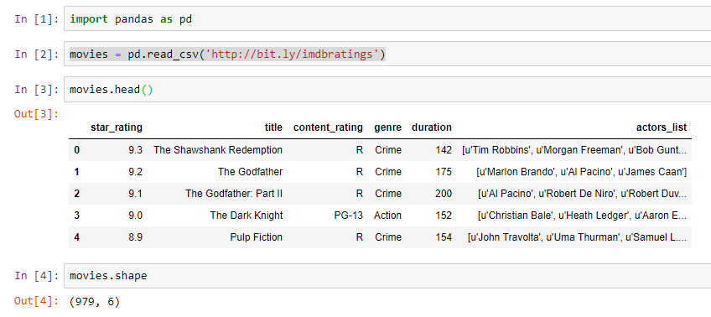
Filtering Rows of a pandas DataFrame
Let’s pull up an example dataset as follows:
Notes:
import pandas as pd
movies = pd.read_csv('http://bit.ly/imdbratings’)
movies.head()
movies.shape

Slide 3

Filtering Rows of a pandas DataFrame
How could we filter the list of movies to show those which are at least 200 minutes long?

Slide 4

Group Discussion
Please spend a few minutes with your team members explain Boolean concept, and, or and not operators.

Slide 5
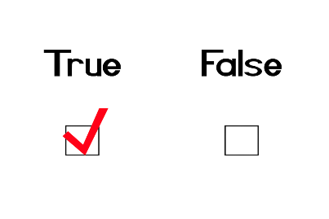
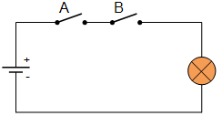
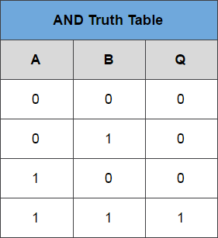
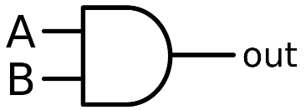
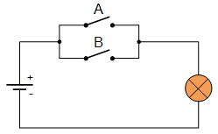
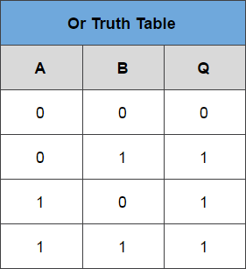
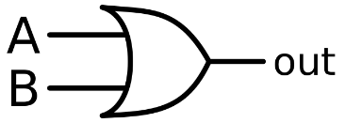
Summary of your Discussion
Boolean
And
Or

Slide 6
Filtering Rows of a pandas DataFrame
We are going to create a Python list of Booleans that has the same exact length of the DataFrame and for each row we examine the following condition:
True
For rows that the duration >= 200
Boolean
False
For rows that the duration < 200
False
False
True
False
False

Slide 7
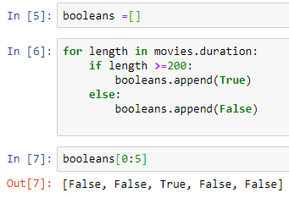
Filtering Rows of a pandas DataFrame
Let’s check our DataFrame to see which one has 200 or more minutes (True) and which one has less (False).
False
False
True
False
False
Notes:
booleans =[]
for length in movies.duration:
if length >=200:
booleans.append(True)
else:
booleans.append(False)
booleans[0:5]

Slide 8

Filtering Rows of a pandas DataFrame
And if we check the length of Boolean it has the same length as the DataFrame.
It effectively tells us which rows match the condition.
Notes:
booleans =[]
for length in movies.duration:
if length >=200:
booleans.append(True)
else:
booleans.append(False)
booleans[0:5]
len(booleans)

Slide 9
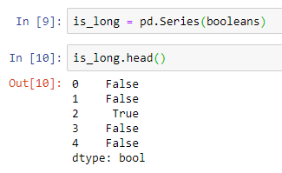
Filtering Rows of a pandas DataFrame
In the next step, we convert the Booleans list to a pandas Series.
Notes:
is_long = pd.Series(booleans)
is_long.head()

Slide 10
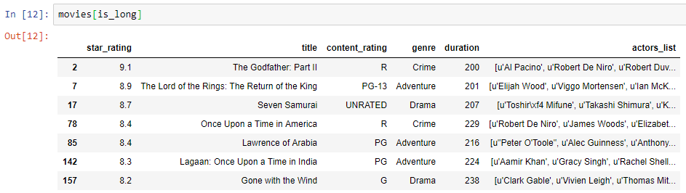
Filtering Rows of a pandas DataFrame
The following command lists the DataFrame rows that the is_long Series has True values in them. In other words, it shows those lines that fulfills the condition, which is having equal or greater than 200 minutes duration.
Notes:
movies[is_long]

Slide 11

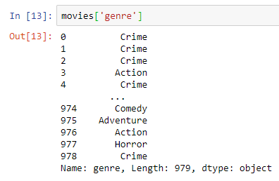
Filtering Rows of a pandas DataFrame
Normally, we use brackets when we want to pulling out the given column.
Notes:
movies['genre']

Slide 12


Question for Reza…
Q: Reza! It was a cumbersome process… Should we change our field of study? Or there is a shortcut for it… A magic pill sort of thing maybe?
R: Yes! There is a shortcut!

Slide 13
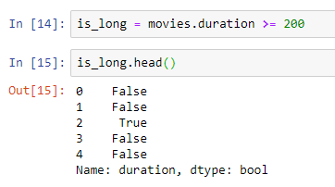
Filtering Rows of a pandas DataFrame
We can simply write the following code to replace our for-loop.
When you say movies.duration >= 200, pandas understand you want to do this comparison against each element in the Series and return a Series of true or false values.
Notes:
is_long = movies.duration >= 200
is_long.head()

Slide 14
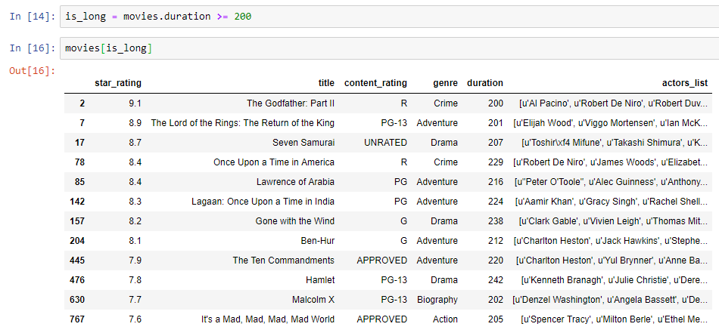
Filtering Rows of a pandas DataFrame
So, we can simply pass this newborn is_long to our movies as follows:
Notes:
is_long = movies.duration >= 200
movies[is_long]

Slide 15


Question for Reza…
Q: Reza! I kinda started liking pandas and Python… but is there any easier way?
R: Yes! There is!

Slide 16
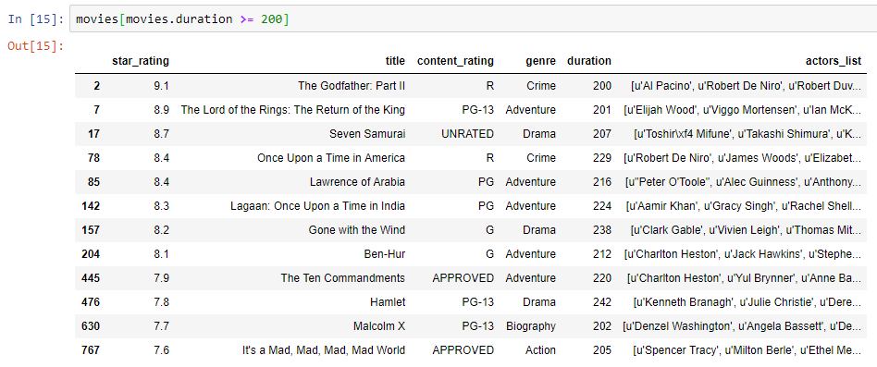
Filtering Rows of a pandas DataFrame
The following code is all-in-one command that filters and shows the rows which fulfill the criteria:
Notes:
movies[movies.duration >= 200]

Slide 17

Bonus Tip
What if we want to just see the genre of the movies that are greater than or equal 200 minutes? In other words, we only want to see those rows of genre column that the duration is greater than or equal 200 minutes.
Please note that the output of the above command is a DataFrame. So, like any other DF, we can access to its Series using a dot.
DataFrame

Slide 18
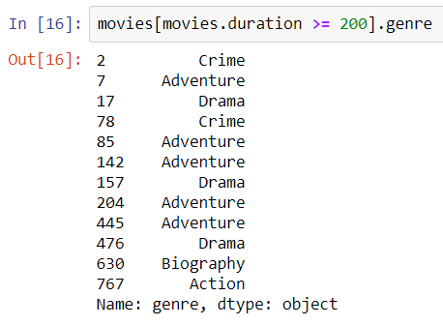
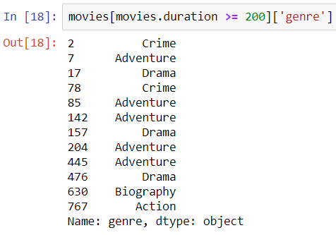
Bonus Tip
The following is the code to show the genre column, where the duration of the movie is greater than or equal 200 minutes.
OR
Notes:
movies[movies.duration >= 200].genre
movies[movies.duration >= 200]['genre’]

Slide 19

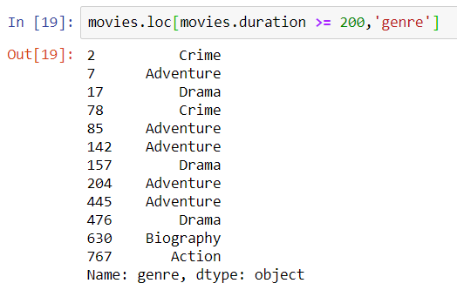
Bonus Tip
Instead of the previous command the following is the most effective command to do the same job.
Here is the rows I want
Here is the column(s) I want
Notes:
movies.loc[movies.duration >= 200,'genre']
movies.loc[movies.duration >= 200,['genre','title']]

Slide 20

Thank you
Question?
To be
Not to be

